Slide 1


UNIVERSITY OF ENGINEERING & MANAGEMENT, KOLKATA
Course Name : Database Management System
Dr. Sandip Mandal
Dept. of CSE, UEM Kolkata
WhatsApp : +91-8449007365
Email : sandip.mandal@uem.edu.in

Slide 2
Module 2: Extension of ER Model and UML
 | UNIVERSITY OF ENGINEERING & MANAGEMENT, KOLKATA

Slide 3
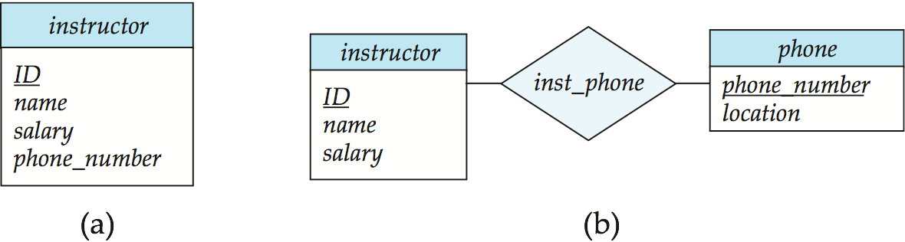
Entities vs. Attributes
 | UNIVERSITY OF ENGINEERING & MANAGEMENT, KOLKATA
Use of entity sets vs. attributes
Use of phone as an entity allows extra information about phone numbers (plus multiple phone numbers)
Notes:
3

Slide 4
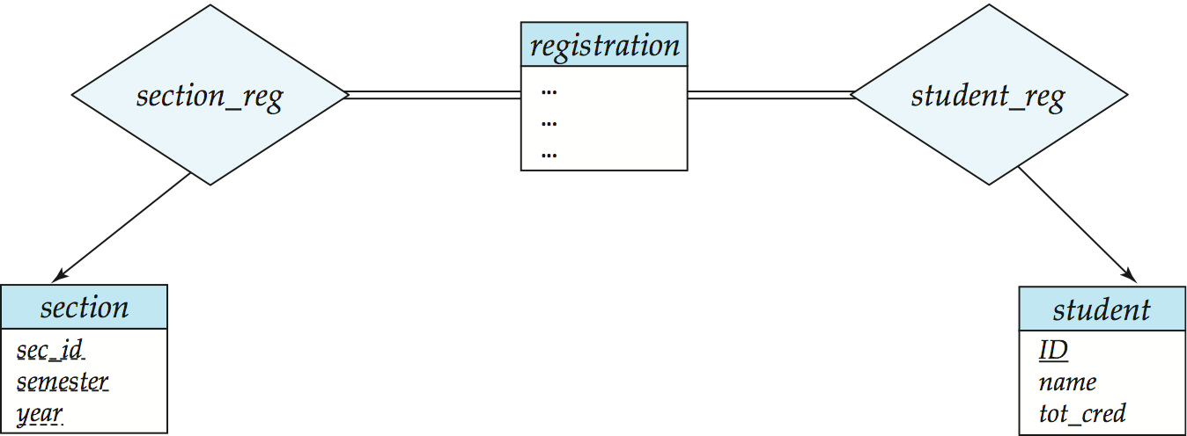
Entities vs. Relationship sets
 | UNIVERSITY OF ENGINEERING & MANAGEMENT, KOLKATA
Use of entity sets vs. relationship sets
Possible guideline is to designate a relationship set to describe an action that occurs between entities
Placement of relationship attributes
For example, attribute date as attribute of advisor or as attribute of student
Notes:
4

Slide 5
Binary Vs. Non-Binary Relationships
 | UNIVERSITY OF ENGINEERING & MANAGEMENT, KOLKATA
Although it is possible to replace any non-binary (n-ary, for n > 2) relationship set by a number of distinct binary relationship sets, a n-ary relationship set shows more clearly that several entities participate in a single relationship.
Some relationships that appear to be non-binary may be better represented using binary relationships
For example, a ternary relationship parents, relating a child to his/her father and mother, is best replaced by two binary relationships, father and mother
Using two binary relationships allows partial information (e.g., only mother being known)
But there are some relationships that are naturally non-binary
Example: proj_guide
Notes:
5

Slide 6
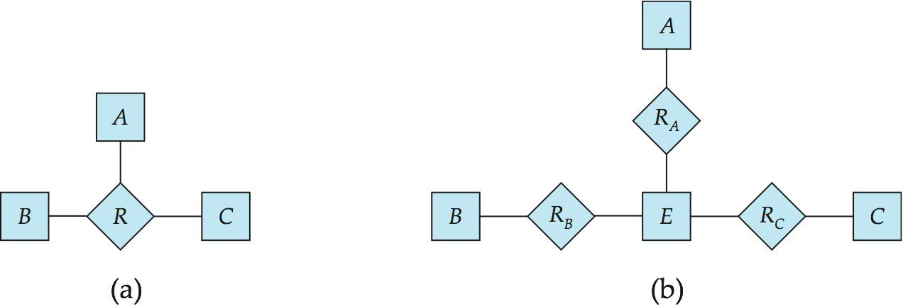
Converting Non-Binary Relationships to Binary Form
 | UNIVERSITY OF ENGINEERING & MANAGEMENT, KOLKATA
In general, any non-binary relationship can be represented using binary relationships by creating an artificial entity set.
Replace R between entity sets A, B and C by an entity set E, and three relationship sets:
1. R_{A}, relating E and A 2. R_{B}, relating E and B 3. R_{C}, relating E and C
Create an identifying attribute for E and add any attributes of R to E
For each relationship (a_{i} , b_{i} , c_{i}) in R, create
1. a new entity e_{i} in the entity set E 2. add (e_{i} , a_{i} ) to R_{A}
3. add (e_{i} , b_{i} ) to R_{B} 4. add (e_{i} , c_{i} ) to R_{C}
Notes:
6

Slide 7
Converting Non-Binary Relationships (Cont.)
 | UNIVERSITY OF ENGINEERING & MANAGEMENT, KOLKATA
Also need to translate constraints
Translating all constraints may not be possible
There may be instances in the translated schema that cannot correspond to any instance of R
Exercise: add constraints to the relationships R_{A}, R_{B} and R_{C} to ensure that a newly created entity corresponds to exactly one entity in each of entity sets A, B and C
We can avoid creating an identifying attribute by making E a weak entity set (described shortly) identified by the three relationship sets
Notes:
7

Slide 8
E-R Design Decisions
 | UNIVERSITY OF ENGINEERING & MANAGEMENT, KOLKATA
The use of an attribute or entity set to represent an object.
Whether a real-world concept is best expressed by an entity set or a relationship set.
The use of a ternary relationship versus a pair of binary relationships.
The use of a strong or weak entity set.
The use of specialization/generalization – contributes to modularity in the design.
The use of aggregation – can treat the aggregate entity set as a single unit without concern for the details of its internal structure.

Slide 9
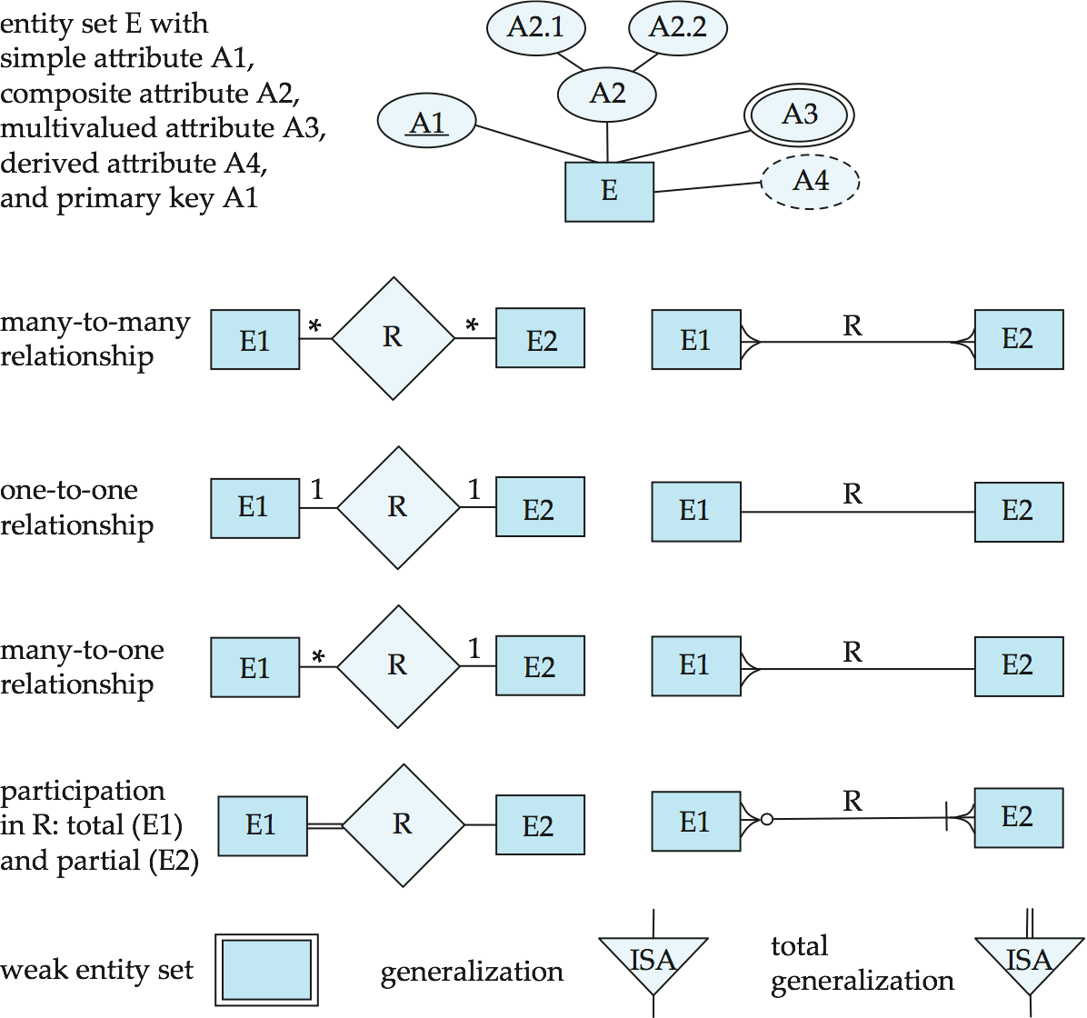
Alternative ER Notations
 | UNIVERSITY OF ENGINEERING & MANAGEMENT, KOLKATA
Chen, IDE1FX, …

Slide 10
Alternative ER Notations
 | UNIVERSITY OF ENGINEERING & MANAGEMENT, KOLKATA
Chen IDE1FX (Crows feet notation)

Slide 11
UML
 | UNIVERSITY OF ENGINEERING & MANAGEMENT, KOLKATA
UML: Unified Modeling Language
UML has many components to graphically model different aspects of an entire software system
UML Class Diagrams correspond to E-R Diagram, but several differences.

Slide 12
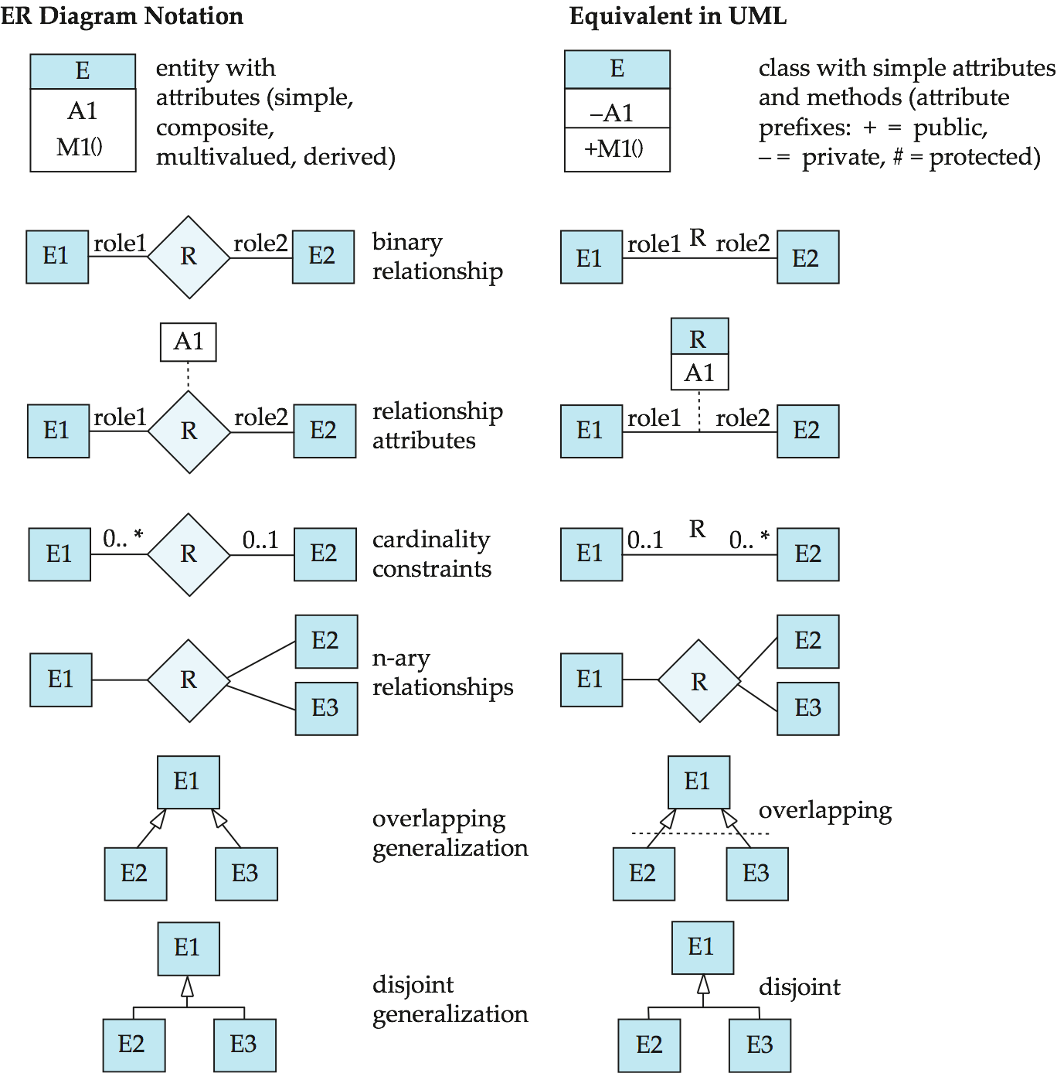
ER vs. UML Class Diagrams
 | UNIVERSITY OF ENGINEERING & MANAGEMENT, KOLKATA

Slide 13
ER vs. UML Class Diagrams
 | UNIVERSITY OF ENGINEERING & MANAGEMENT, KOLKATA
ER Diagram Notation
Equivalent in UML

Slide 14
UML Class Diagrams (Cont.)
 | UNIVERSITY OF ENGINEERING & MANAGEMENT, KOLKATA
Binary relationship sets are represented in UML by just drawing a line connecting the entity sets. The relationship set name is written adjacent to the line.
The role played by an entity set in a relationship set may also be specified by writing the role name on the line, adjacent to the entity set.
The relationship set name may alternatively be written in a box, along with attributes of the relationship set, and the box is connected, using a dotted line, to the line depicting the relationship set.

Slide 15

 | UNIVERSITY OF ENGINEERING & MANAGEMENT, KOLKATA
Thank You

